Slide 1
Sales Analysis Dashboard Summary (2013-2014)
This presentation summarizes the financial performance analysis for the years 2013 and 2014, highlighting Total Sales, Total Profit, and Total Units Sold across multiple countries and products.

Slide 2
Content
Objective
Dashboard Overview
2013 Performance Overview
Total Sales
Total Profit
Total Units Sold
2014 Performance Overview
Total Sales
Total Profit
Total Units Sold
Comparative insights (2013 vs 2014)
Key takeaways

Slide 3

Objective
This dashboard aims to analyse sales performance across countries and products over 2013 and 2014, focusing on Total Sales, Total Profit, and Total Units Sold. Key insights help drive strategic business decisions based on year-over-year growth and country/product performance.

Slide 4

Dashboard overview
Interactive filters: Year, Parameter (Sales, Profit, Units), Country.
KPIs tracked: Total Sales, Total Profit, Units Sold, Year-over-Year Growth %.
Visuals: Donut charts (country distribution), Bar charts (product-wise performance),
Tables (detailed numbers).

Slide 5
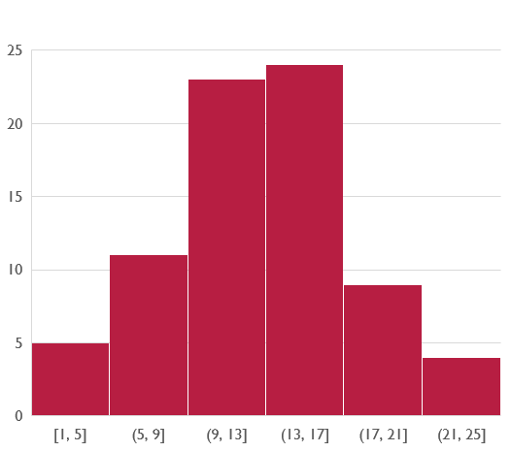
2013 Sales summary

Slide 6
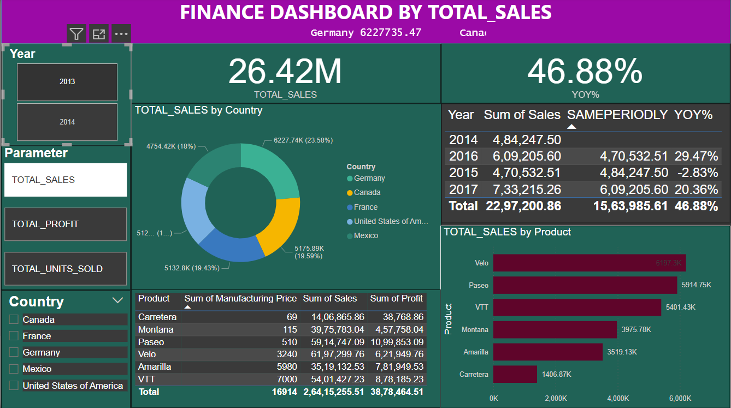

Slide 7
2013 ~ Total sales
Summary:
Total Sales: $9.23M
Leading Countries: United States, Canada, France
Leading Products: Paseo, VTT, Amarilla
YOY Growth: 46.88%

Slide 8
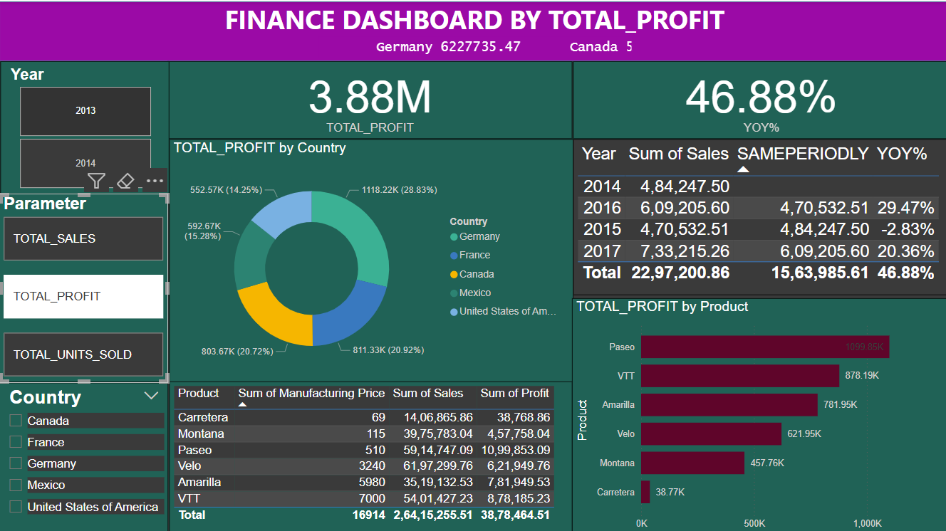

Slide 9
2013 ~ Total profit
Summary:
Total Profit: $13.02M
Top Countries by Profit: France (22.82%), Canada (20.94%), Germany (19.69%)
Top Products by Profit: Paseo, VTT, Amarilla

Slide 10
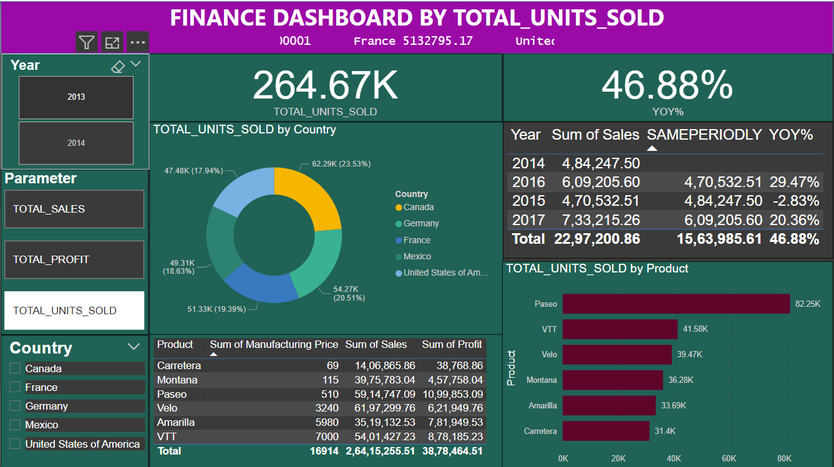

Slide 11
2013 ~ Total units sold
Summary:
Total Units Sold: 264.67K units
Highest Units Sold by Country: Canada, Germany, France
Leading Products by Units Sold: Paseo, VTT, Velo

Slide 12
2014 Sales Summary

Slide 13
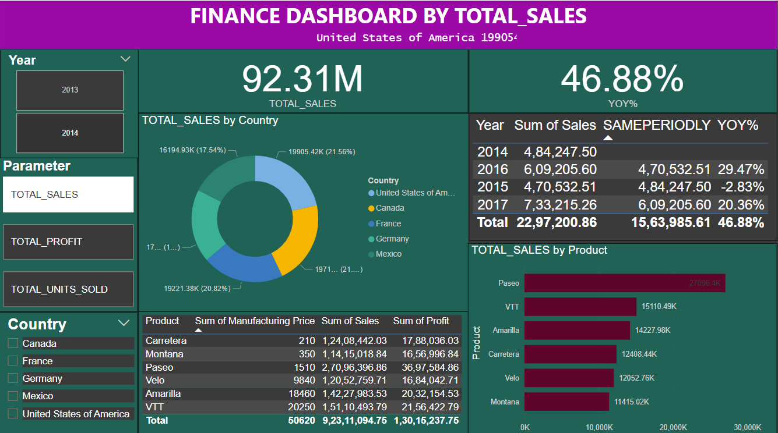

Slide 14
2014 ~ Total sales
Summary:
Total Sales: $9.23M (same as 2013 — check if data differs slightly)
Top Countries: United States, Canada, France
Top Products: Paseo, VTT, Amarilla

Slide 15
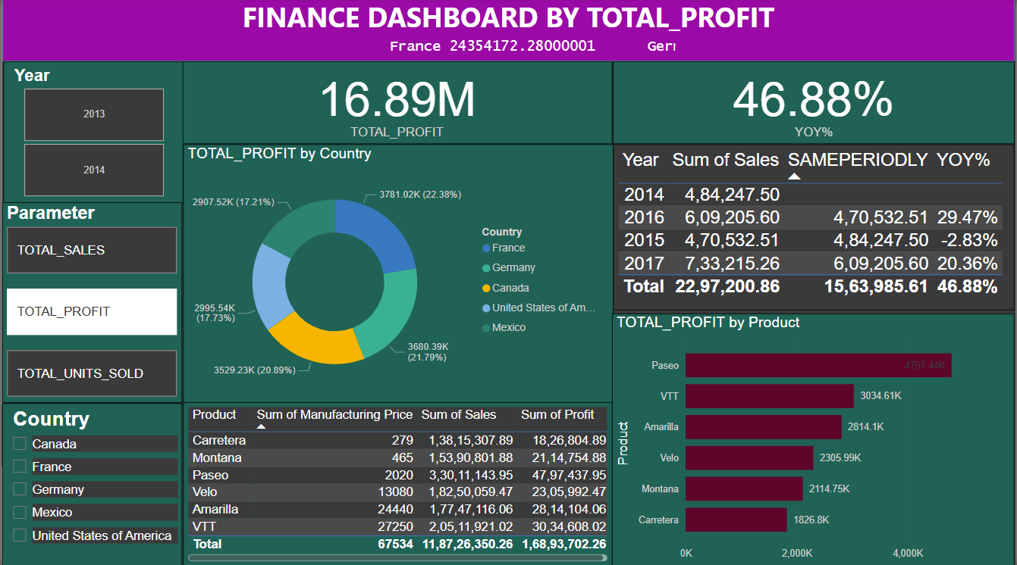

Slide 16
2014 ~ Total profits
Summary:
Total Profit: $13.02M
Major Contributors: France, Canada, Germany
Top Profitable Products: Paseo, VTT, Amarilla

Slide 17
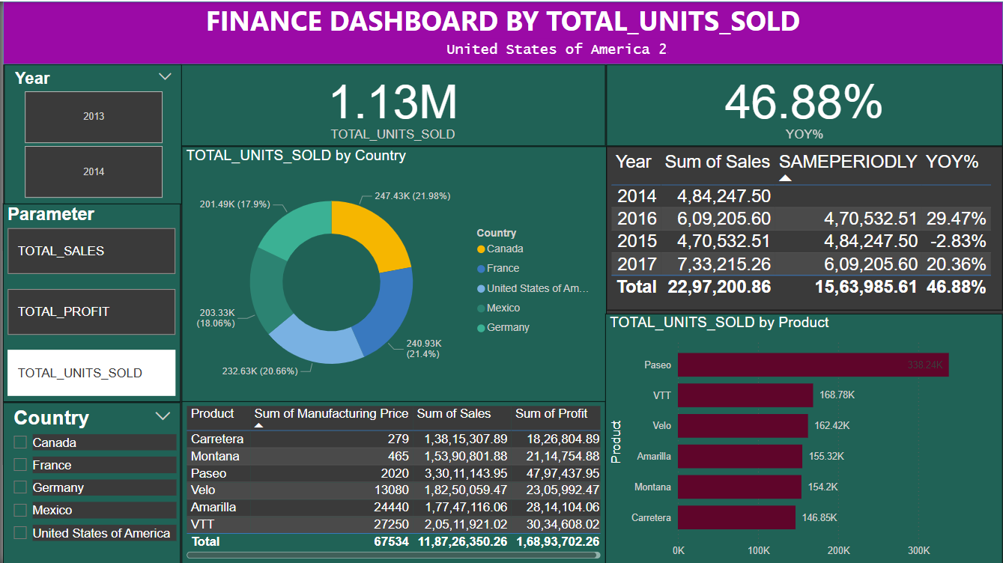

Slide 18
2014 ~ total units sold
Summary:
Total Units Sold: 861.13K units (huge growth compared to 2013)
Key Countries: France, United States, Canada
Best-Selling Products: Paseo, VTT, Velo

Slide 19
Year on year comparison (2013 v/s 2014)
Summary:
Significant increase in Total Units Sold.
Paseo remains the top performer in both years.
YOY % growth remained stable at 46.88%.
United States and France strengthened positions as top countries.

Slide 20
Key takeaways
Summary:
Strong upward trend in profit and units sold (YOY growth of 46.88%).
Paseo consistently dominates across all metrics.
France and Canada are consistently top-performing countries.
Focus should continue on best-performing products (Paseo, VTT) and leading countries for future strategies.

